Slide 1
Group 12 – Dungeon Crawler
KATIE MILLAR, STEFAN SIMULETE, ALEXANDER MOORE, DANIEL BAILEY

Slide 2
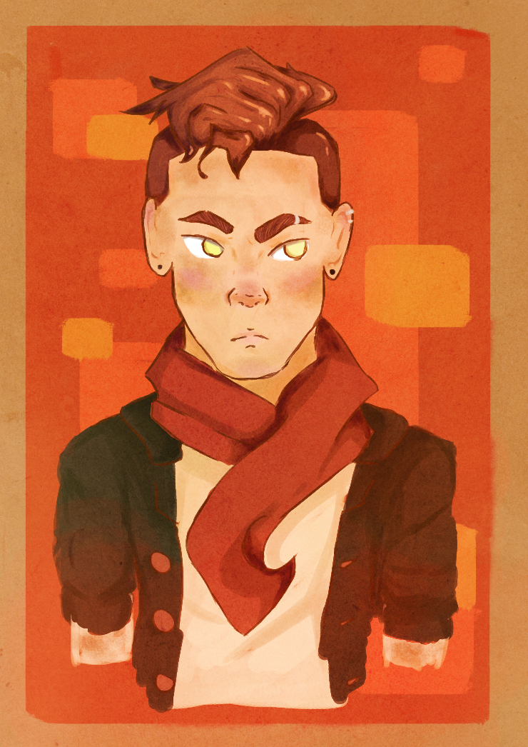
The Brief
Key Points of the Brief –
Single-player
Developed without core mechanic of genre
Substitution of core mechanic with a new, refined mechanic

Slide 3
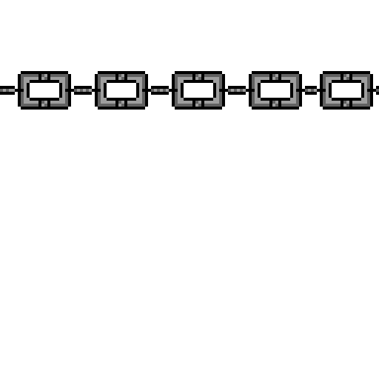
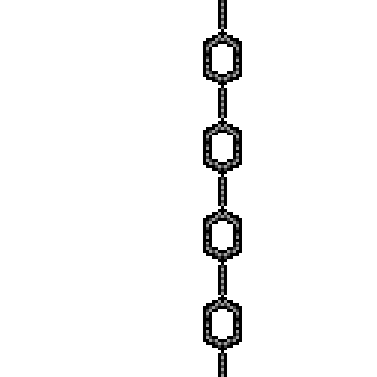
Our response to the Brief
Single-player Dungeon Crawler.
Shooting Mechanic Removed – instead players lay traps.
What does the player do?
The player avoids direct confrontation. This makes the player feel powerless and results in gratification as they grow stronger.
Players plan out actions ahead of time. This makes the player exploit enemy patterns.
The player dodges enemy fire. They must avoid getting hit and escape the assailants which requires planning in a stressful situation.
Foresight, Traps take time to place so they must be set ahead of time. This requires the player to engage in long term planning.
We are hoping that players experience…
Panic, when plans go wrong the player will be forced to try and evade capture enhanced by the players fragility.
Exhilaration, successfully carrying out a plan makes the player feel smart
Tension, the constant threat of detection serves to put the player on edge as failure is always near.

Slide 4
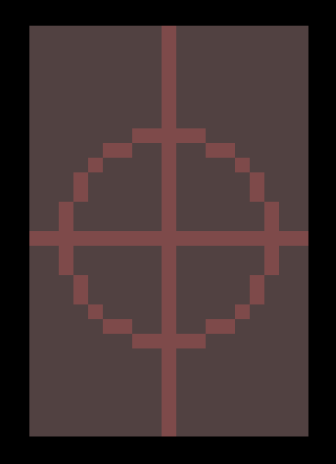
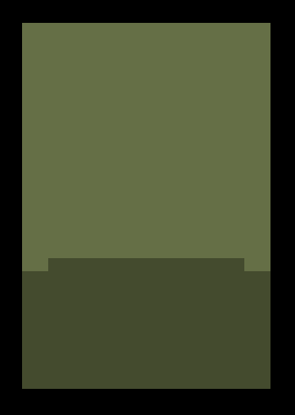



Core game loop
Player watches enemy movement and places traps in their path
Enemies are trapped
Player progresses to the next room.

Slide 5
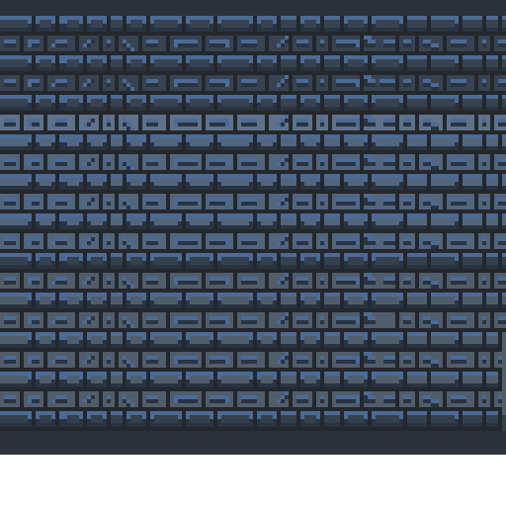
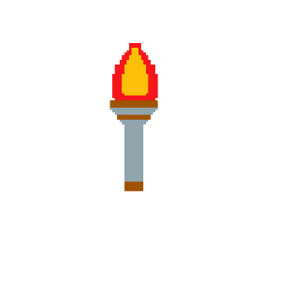
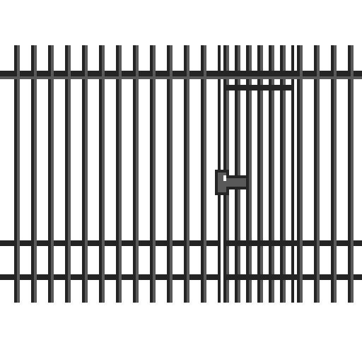
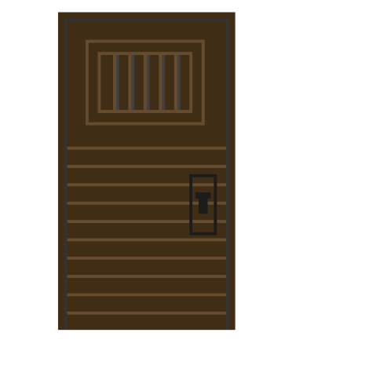
Programming Challenges
Completed Features
A* Pathfinding
Trigger overlaps
Movement changes
Unity Crashes
Player Movement
Enemy movement after finding player
Enemy interacts with traps
Starting traps break before kill
Bullet Launch
Bullet Collisions
Player health
Game over- HP 0 – Temp: Stop time
Player Placing Traps
Features to add
Trap progression
Trap Pickups
Level Building/ progression
Camera scroll into next room
HUD
Menu
Timer
High Score

Slide 6
Video Footage

Slide 7

Any questions?

